Slide 1
OSG Area Coordinators
Network Monitoring Update: February 22, 2017
Shawn McKee

Slide 2
Review Networking Goals Year 5
Maintain / update the OSG networking services / documentation.
Reach out to non-WLCG OSG sites; Integrate those interested:
Advertise that OSG is ready to help sites with networking issues via:
OSG web pages
Targeted email (Cyberinfrastructure list, perfSONAR user list, etc)
Via interactions with sites at conferences and meetings.
Encourage as many NSF CC*xxx sites as possible to integrate their perfSONAR instances into OSG networking; OSG will provide them a mesh-configuration and gather their data.
Provide Soichi’s standalone mesh-configuration tool for use by campuses and VOs.
OSG will create a network alerting service to find “obvious” network problems
This will involve the creation of a suitable analysis pipeline such that perfSONAR data can be analyzed on a timescale of every 1-2 hours.
Obvious problems include significant decrease in bandwidth between a source and destination or continuing significant packet loss along a path or correlated with a specific site.
Actual alerts will be issued by GOC staff based upon alarms they receive.
Enable automated alerting (email, SMS) on well identified alarms.
This is a “reach” goal for the year but I think it should be feasible
Requires accurate, synchronized mapping of sites to contacts
Tunable pattern of alerts (e.g., 1 alert, wait 1 day and alert if problem continues, then every 3 days until fixed)

Slide 3
Review: The Slipped Milestones
Recruiting of 10 new sites for OSG networking -- October 31, 2016 (slipped)
Side tracked still waiting for MCA and pS v4.0
Initial release of Soichi’s standalone mesh-configuration utility packaged and available --- September 30, 2016 (Moved)
More details on status later
Initial Alarming system into production --- December 1, 2016 (partial) – more later

Slide 4
Recruiting non-WLCG Sites
One passed set of milestones was to recruit 10 (or more) non-WLCG sites who have perfSONAR instances to “join” OSG
This means they use the OSG mesh-configuration to define tests
OSG will gather metrics from their instances
Our dashboard and check_mk will display their metrics and monitor their perfSONAR services
Delayed: still waiting for the standalone meshconfig and perfSONAR v4.0
Makes sense to recruit when those are ready
Plan a target email campaign soon.
Operations + User Support help?
Suggestions needed and welcome.

Slide 5
Standalone Mesh-config (MCA)
Soichi was approved Nov 16 to work 20% on this for 4 months followed by 10% for 2 months
Started in January
Great progress since then
Documentation at http://docs.perfsonar.net/mca and at https://github.com/soichih/meshconfig-admin
Issues tracked at https://github.com/soichih/meshconfig-admin/issues (14 open, 7 closed)
OSG instance running at https://meshconfig-itb.grid.iu.edu/ (create an account to play with this)
Now 257 hosts imported from OIM/GOCDB
New API available https://meshconfig-itb.grid.iu.edu/apidoc/
Close to being ready to use for production

Slide 6
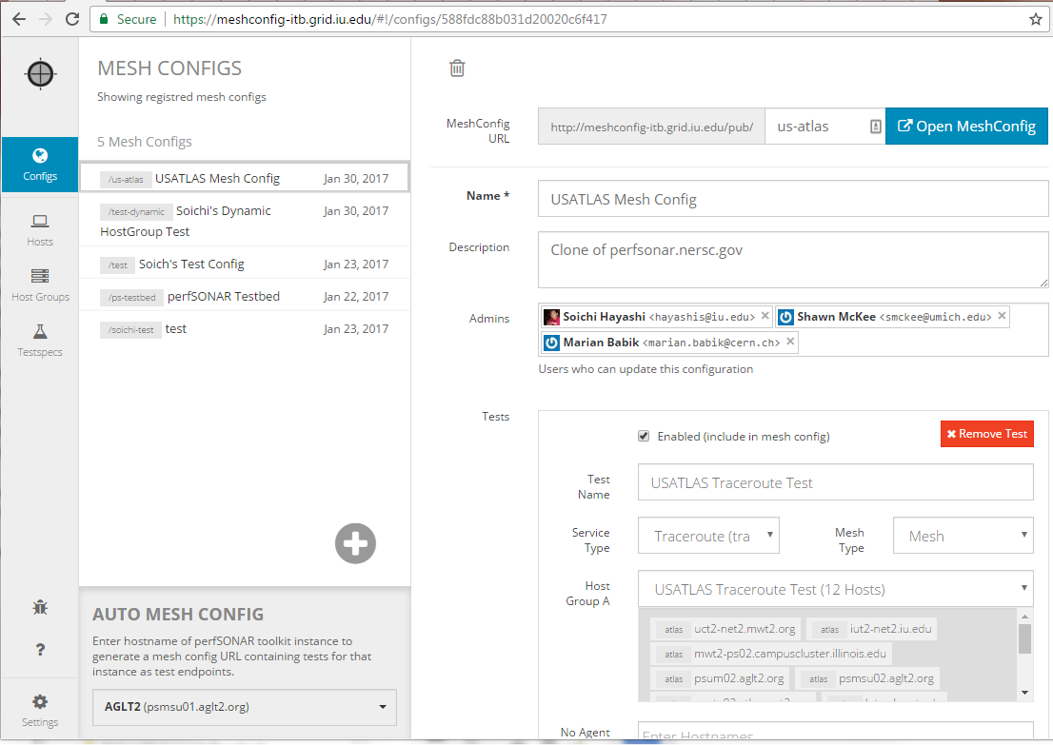
MCA Screenshot

Slide 7
Enabling Alarming
We have a longer term goal of alerting and alarming on network issues.
Milestone completed: technical design of a suitable analysis system based upon existing time-series technologies
Current operating implementation gathers all perfSONAR data OSG sends to CERN and puts it in ElasticSearch.
Jupyter instance regularly runs cron tasks to analyze data
Anyone can subscribe to simple alert-emails.
http://tiny.cc/RegATLASAlarm
Not “production” yet. Will need lots of packaging for end-user use.

Slide 8
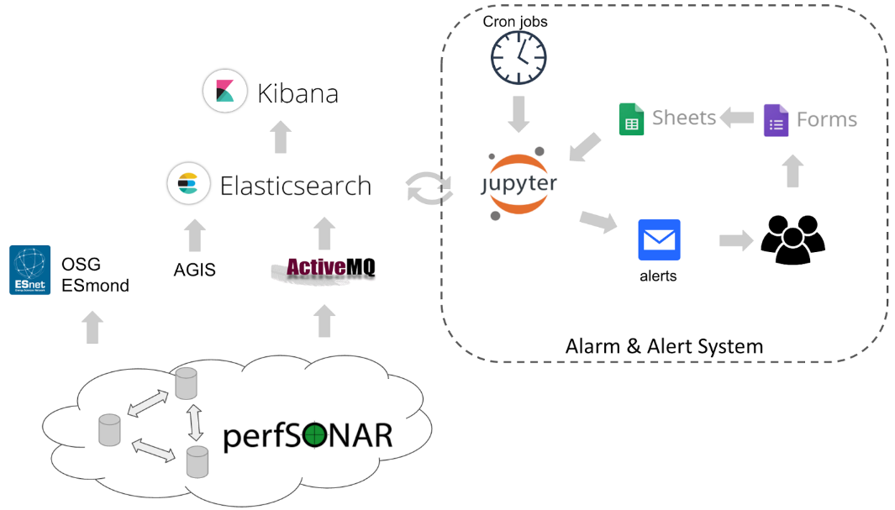
Logical Diagram: Alarm/Alert System

Slide 9
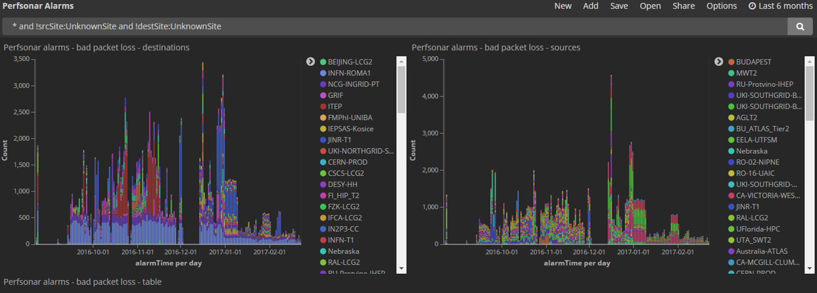
Examples of Network Analytics
Using the ELK setup from Ilija Vukotic/UC we can look at some of the network data results
This link shows the last 6 months of packet loss results by source/destination: http://tiny.cc/PktLossNoUnknown

Slide 10
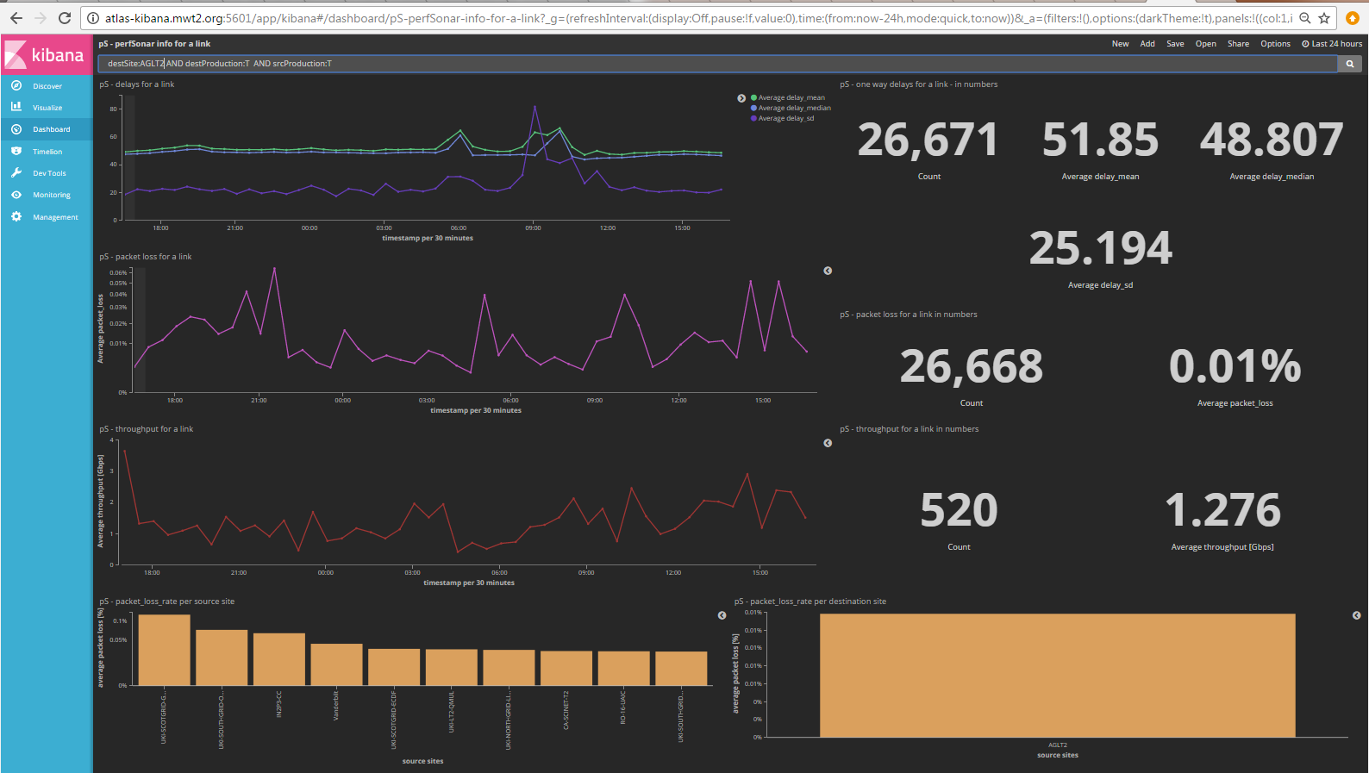
We can analyze in the context of a specific site or link. Example http://tiny.cc/pSLink

Slide 11
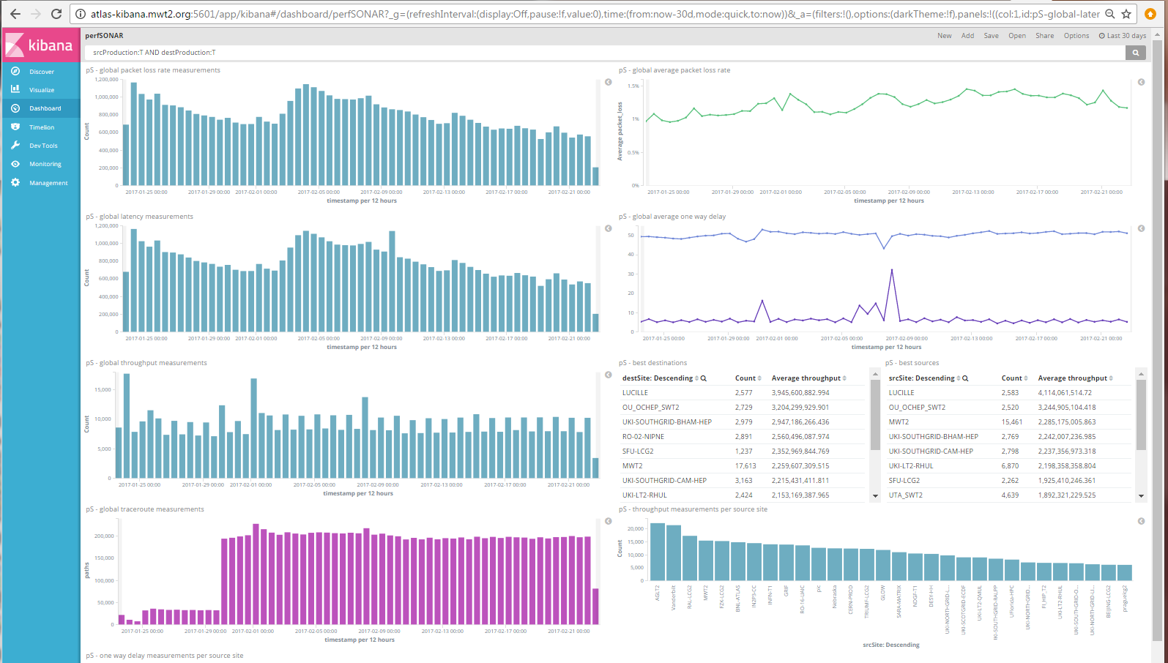
This example shows measurements being made and captured by OSG http://tiny.cc/pSDash

Slide 12
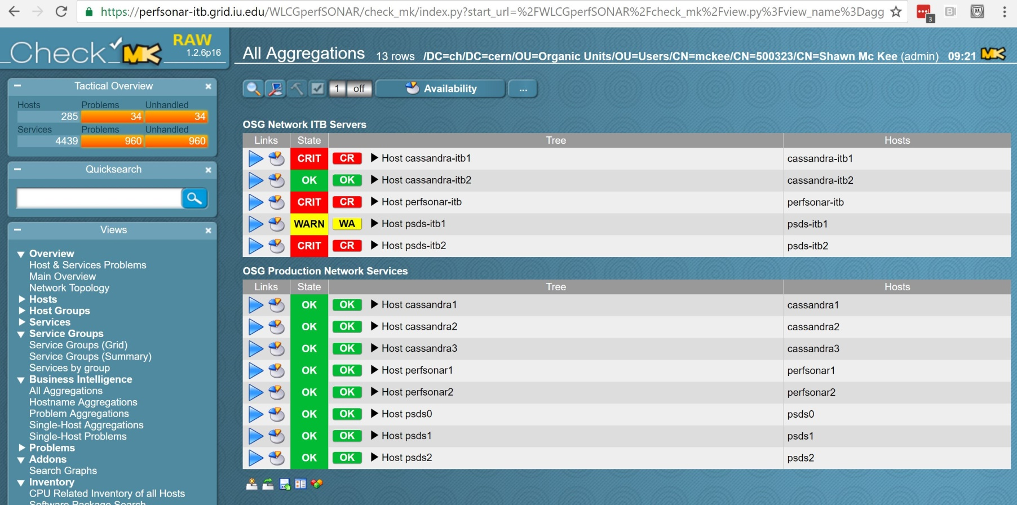
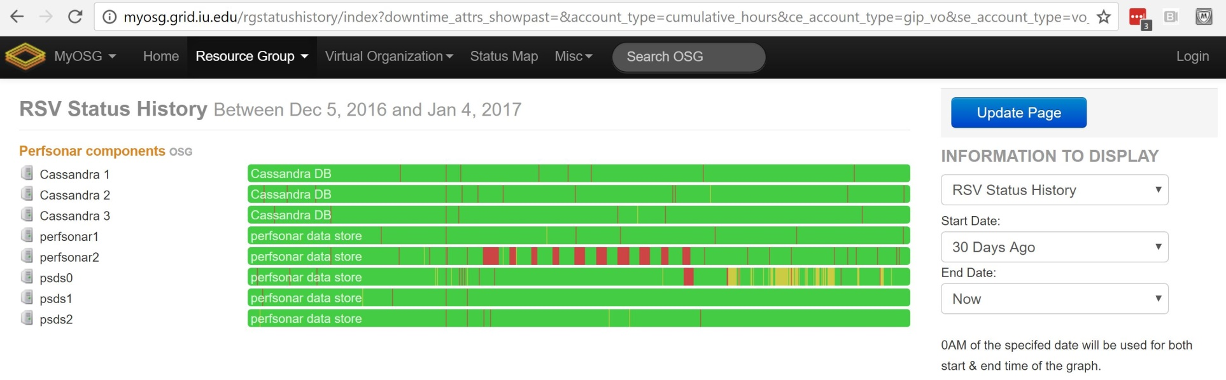
Status of OSG Net Services(last)

Slide 13
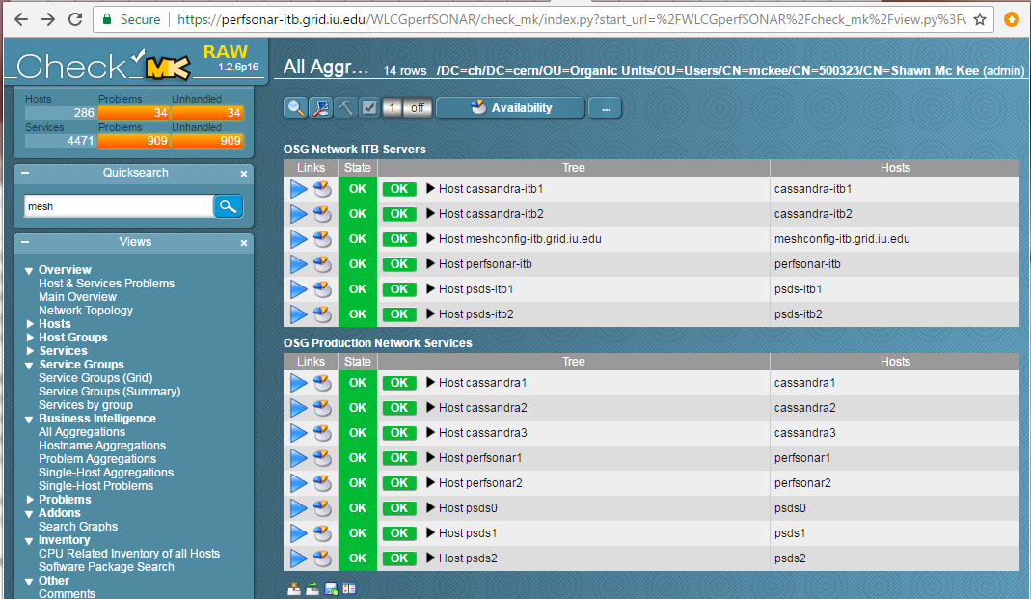
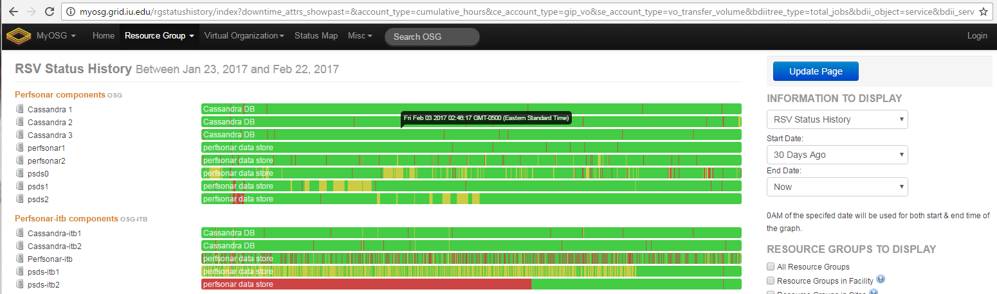
Status of OSG Net Services
Config Changes

Slide 14
Service “Challenges”
As you can see on the previous 30 day RSV status we have had some occasional problems with some services
MaDDash mitigation with cron restart script from Scott working
New issues with publishing data to CERN ActiveMQ.
Two events where publishing stopped: around 10:25 PM on Saturday Feb 11 and Feb 18. Investigation pointed out some problems with lack of needed log access
See ongoing ticket https://ticket.opensciencegrid.org/32653
Scott noted the Business Intelligence summary was indicating too many problems…should only go critical when a response is needed
Next few slides show remediation/configuration changes
The ITB instances have had problems. Full /var, MaDDash up/down, intermittent load issues. Not critical because it’s ITB. Mostly working
Would still like to get check_mk monitoring on the virtualization hosts.
Useful to understand resource use and possible conflicts
Is opening a ticket the best way to get this?

Slide 15
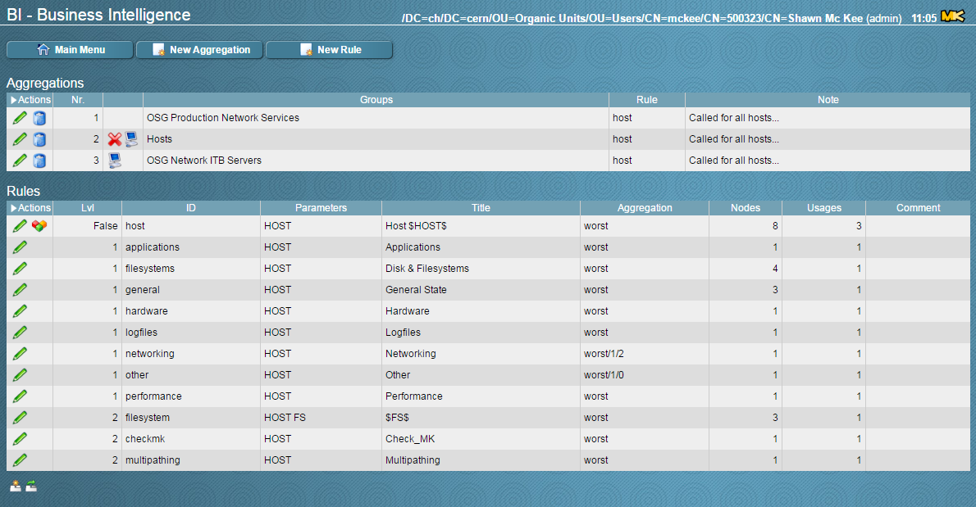
Reconfiguring Business Intelligence
The check_mk BI rolls-up the summary state of a number of groups of checks
For OSG we track Production and ITB groups
Within each group we summarize the state of each host

Slide 16
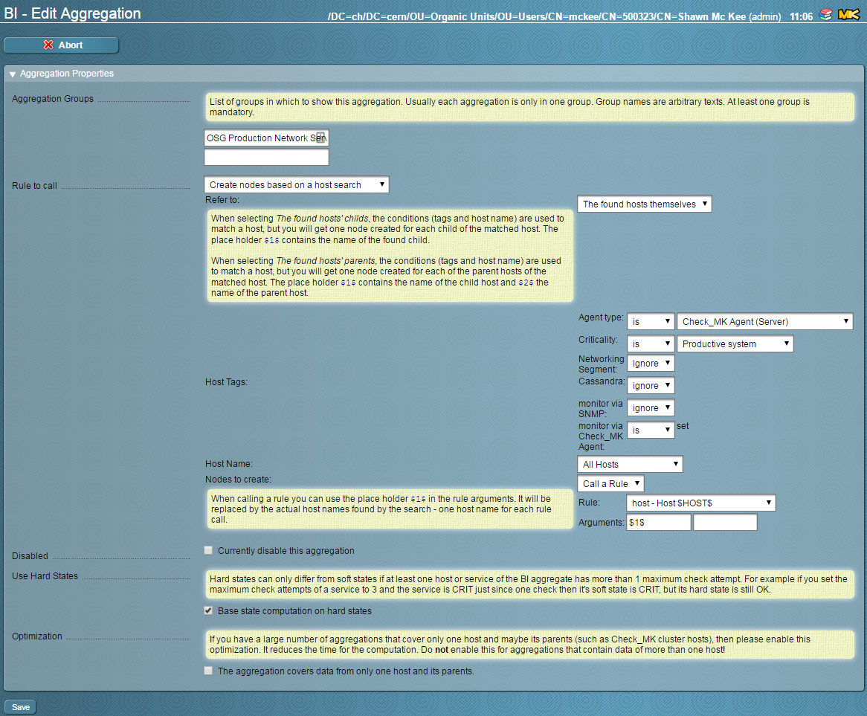
Reconfiguring Business Intelligence(2)

Slide 17
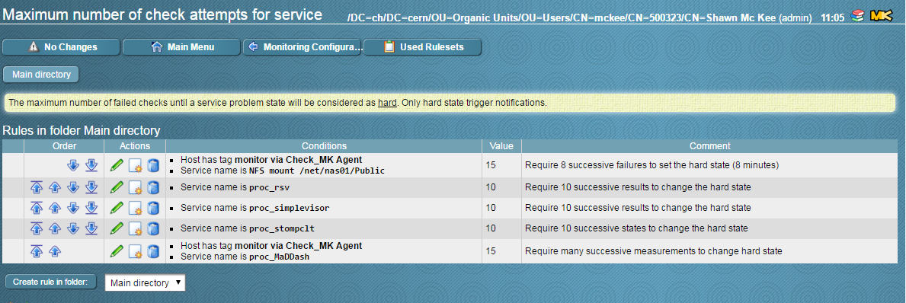
Reconfiguring Rules for Hard State
Some services have transitions or intermittent glitches we don’t want to signal on.
Check_mk supports both hard and soft service states.
Hard states only change after the soft state has changed and stayed changed for N measurements
Set limits to match typical observed glitch-level

Slide 18
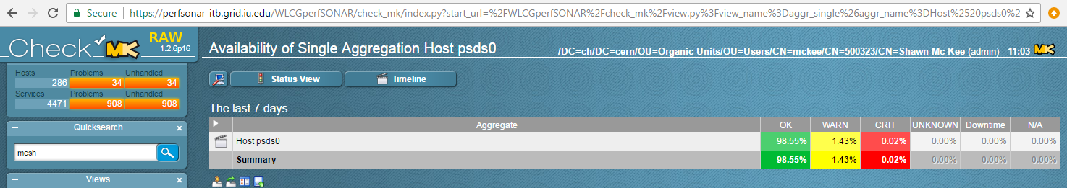
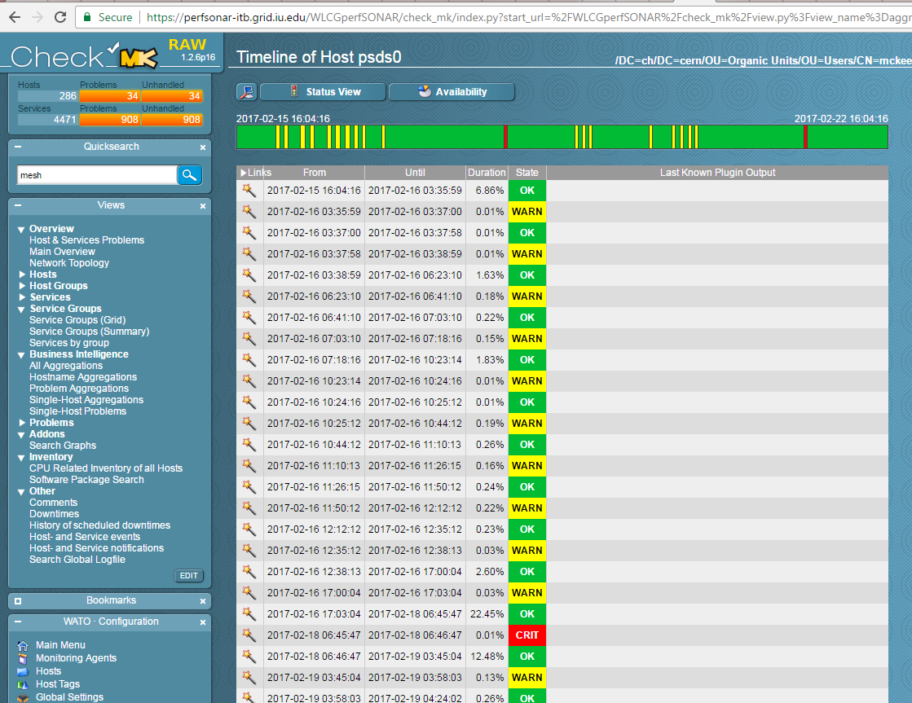
Timelines of psds0 Example

Slide 19
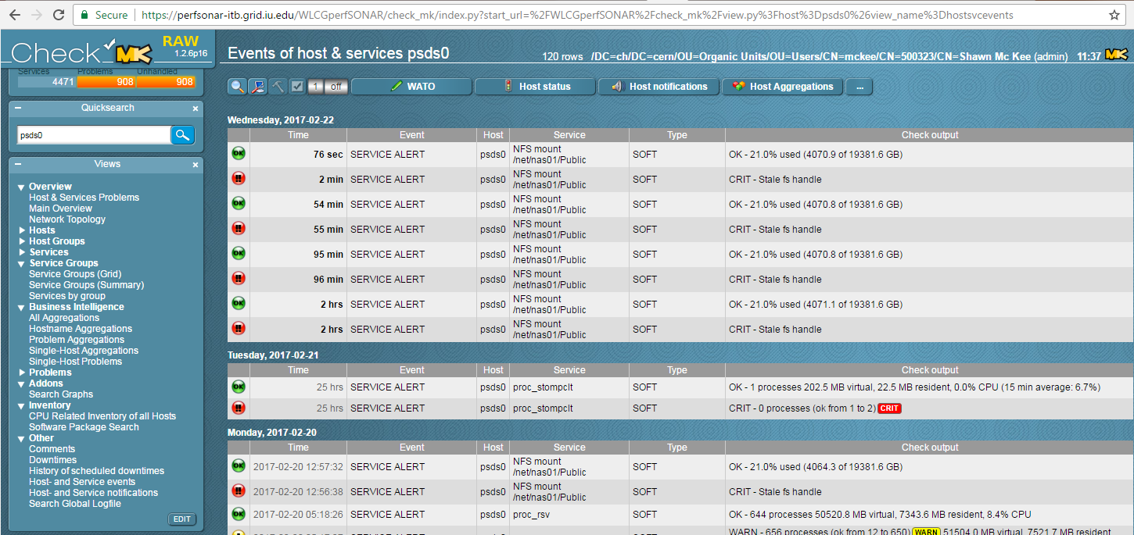
Tracking Service History
We can provide a “service history” view
Useful to understand behavior in time
Need to iterate with Ops to track RSV status and tweak sensitivity

Slide 20
perfSONAR v4.0 / MaDDash 2.0
The perfSONAR v4.0 release was delayed from the nominal Dec 1 2016 date
Needed an RC3 release to follow-up on more issues found in RC2…still not out yet ☹
Targeting ~March, 2017 for RC3
Release in April?!?
MaDDash 2.0 is close to ready.
Once these are released we will want to update ITB and then Production
Will need a global campaign to get sites updated
Details on upcoming OSG “upgrades” on next slide

Slide 21
Supporting ALL perfSONAR Metrics
When we initial setup the perfSONAR RSV probes and ActiveMQ message queue at CERN we only supported part of all the possible data metrics perfSONAR can measure.
Both the RSV probes and Stompctl/ActiveMQ systems need to support all possible perfSONAR metric types
Required changes to the RSV probes and ActiveMQ configurations
Since the last report on January 4th this work has been successfully completed and in ITB.
Edgar enabled support and corresponding configuration options in the software. New perfSONAR RSV out.
Thanks to Edgar, OSG Operations and the CERN AMQ team!

Slide 22
Needed Updates
Once perfSONAR v4.0 and MaDDash v2.0 are released we will need to do some updates:
MaDDash 2.0 to perfsonar-itb, then psmad
Deploy MCA to production (currently on meshconfig-itb => meshconfig.grid.iu.edu)
Replace existing OIM version and cut-over (DNS alias), e.g., https://myosg.grid.iu.edu/pfmesh/mine/hostname/ to refer to http://meshconfig.grid.iu.edu/pub/auto/
Update check_mk agents to use 1.2.8p17 (all OSG service hosts)
Update check_mk server to use 1.2.8p17
perfSONAR RSV to production https://ticket.opensciencegrid.org/31257
Updates to Esmond (Cassandra/Postgresql)?

Slide 23
Status: Plan to Address Storage Space
Discussed in detail last time including hardware upgrade plan
The long term solution for data life-cycle mgmt depends upon the choice of measurement archive (MA), the creation of suitable tools for that MA and identification of long-term storage
Won’t happen in time for OSG needs
The near-term plan is to buy ~8 disks and incrementally swap them for smaller disks, minimizing downtime.
Rob Quick can summarize current status

Slide 24
Talks and Papers (Outreach)
There are at least 5 CHEP 2016 submitted referencing OSG Networking
The OSG Network Service
Scaling the PuNDIT project for wide area deployments
Networks in ATLAS
Networking – the view from HEP (Plenary)
Big Data Analytics Tools as Applied to ATLAS Event Data
January 10th was the Pre-GDB on Networking at CERN
OSG’s role in gathering network metrics and alerting and alarming are central items for near-term work
The 2017 ICFA-SCIC Network Monitoring report was submitted http://icfa-scic.web.cern.ch/ICFA-SCIC/meetings.html
Upcoming presentation on Networking
OSG AHM March 8
ATLAS Software and Computing week March 13-17th

Slide 25
Concerns (Much as last time)
Operation of services
OSG production network service still seeing issues
Monitoring was significantly tweaked to be less noisy
MaDDash v1 has had issues. Maybe v2 will fix things?
Challenging to identify root cause/fixes with indirect access
Significant set of updates coming in 30-45 days…need to prep
Identifying suitable non-WLCG sites to benefit from OSG networking services (need ~5 sites identified to recruit)
In limbo because we want new release, new meshconfig and some level of alarming available to use to recruit with
Long-term data lifecycle management
Must implement additional storage
Convergence ongoing on “alarming” system.
Needed components are in place and being played with
Need to harden this and move to broader testing
Build the user-facing interface and verify continuous operation

Slide 26
Questions or Comments?
Thanks!

Slide 27
URLs of Relevance
OSG Network Datastore Documents
Operations https://docs.google.com/document/d/1l144BSo-88M0cLMMjKcKMIE-Q5s21X-w3lYl-0Pn_08/edit#
SLA https://twiki.grid.iu.edu/bin/view/Operations/PSServiceLevelAgreement
Data lifecycle https://docs.google.com/document/d/1mJ1kf43nZf6gvKoNtiTOc0g0MYDv_wSfSm7YdiMs3Lo/edit#
Current OSG network documentation https://www.opensciencegrid.org/bin/view/Documentation/NetworkingInOSG
OSG networking year-5 goals and milestones: https://docs.google.com/document/d/1FzmXZinO4Pb8NAfd5SWUzaAFYOL23dt66hQsDmaP-WI/edit
perfSONAR adoption tracking: http://grid-monitoring.cern.ch/perfsonar_coverage.txt
Deployment documentation for both OSG and WLCG hosted in OSG (migrated from CERN)
https://twiki.opensciencegrid.org/bin/view/Documentation/DeployperfSONAR
ATLAS Analytics:
Packet-loss: http://tiny.cc/PktLossNoUnknown (6 month view)
perfSONAR dashboard: http://tiny.cc/pSDash
perfSONAR link details: http://tiny.cc/pSLink
Mesh-config in OSG https://oim.grid.iu.edu/oim/meshconfig
Pre-Production Meshconfig https://meshconfig-itb.grid.iu.edu/meshconfig/
MadAlert: http://madalert.aglt2.org/madalert/diff.html
perfSONAR homepage: http://www.perfsonar.net/

